Slide 1
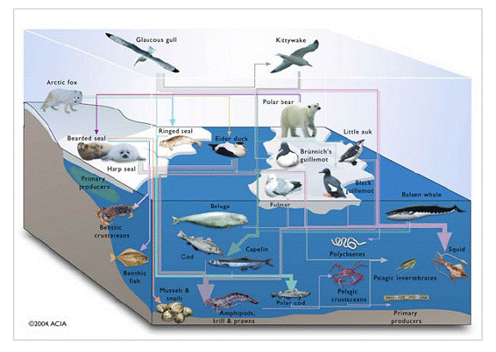
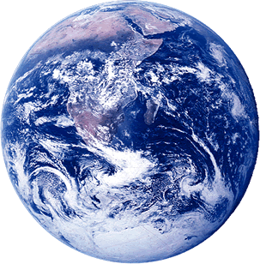
Systems and Scale
Lessons 1, 4, and 5
What happens when ethanol burns?

Slide 2
Lesson 1 Discussion
Your ideas about what happens when ethanol burns

Slide 3
What happens when ethanol burns?
Your ideas
Your questions
Notes:
Optional slide to use with Lesson 1

Slide 4
Lesson 4 Investigation
Investigating Burning Ethanol

Slide 5
Lesson 4 Activity 1
Initial explanations, predictions, and planning

Slide 6
Two Questions about Chemical Change
What is a chemical change?
A change in matter where atoms are rearranged into new molecules.
Two questions that scientists always try to answer about chemical changes that involve carbon atoms:
The Movement Question: Where atoms moving? (Where are atoms moving from? Where are atoms going to?)
The Carbon Question: What is happening to carbon atoms? (What molecules are carbon atoms in before the process? How are the atoms rearranged into new molecules?)

Slide 7
Another Question: The Energy Question
Two facts about energy:
Energy lasts forever. Energy is never created or destroyed in chemical changes.
Energy can be transformed from one form to another. Some common forms of energy include:
Heat
Light
Motion
Chemical energy: energy stored in bonds of molecules
The Energy Question: What is happening to chemical energy?
What forms of energy are involved?
How is energy changing from one form to another?

Slide 8
Answering the questions for ethanol burning
What are your ideas?
The Movement Question: Where atoms moving? (Where are atoms moving from? Where are atoms going to?)
The Carbon Question: What is happening to carbon atoms? (What molecules are carbon atoms in before the process? How are the atoms rearranged into new molecules?)
The Energy Question: What is happening to chemical energy? (What forms of energy are involved? How is energy changing from one form to another?)

Slide 9
Making Predictions
Predicting mass changes
What materials will gain and lose mass when ethanol burns?
How are the mass changes connected with The Movement Question: Where are atoms moving?
Use arrows on the worksheet to show your ideas
Predicting BTB changes
How will ethanol burning change BTB?
How are the BTB changes connected to The Carbon Question: What is happening to carbon atoms?
Explain your ideas on the worksheet.
How do you think that energy is changing from one form to another?
Explain your ideas on the worksheet.

Slide 10
What happens when ethanol burns?
Where are atoms moving from?
Where are atoms moving to?
Chemical change
What molecules are carbon atoms in before the change? What other molecules are involved?
What molecules are carbon atoms in after the change? What other molecules are produced?
What forms of energy are in the reactants?
What forms of energy are in the products?
Remember: Atoms last forever (so you can rearrange atoms into new molecules, but can’t add or subtract atoms) Energy lasts forever (so you can change forms of energy, but energy units can’t appear or go away)
Notes:
Teaser process tool for all investigations except soda water

Slide 11
What Are Your Ideas about the Movement Question?
Where are atoms moving from?
Where are atoms going to?

Slide 12
What Are Your Ideas about the Carbon Question?
What molecules are carbon atoms in before the change? What other molecules are involved?
What molecules are carbon atoms in after the change? What other molecules are produced

Slide 13
What Are Your Ideas about the Energy Question?
What forms of energy are in the reactants?
What forms of energy are in the products?

Slide 14
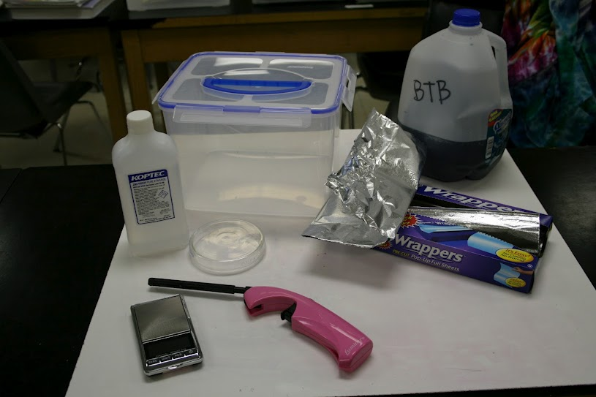
Planning the Investigation
How will you measure mass changes?
How will you observe changes in the color of BTB?

Slide 15
Lesson 4 Activity 2
Investigating ethanol burning

Slide 16
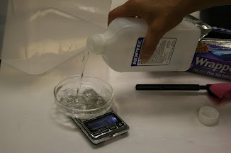
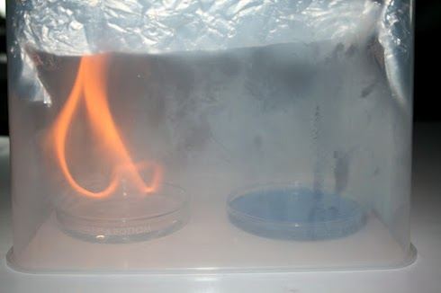
Let’s do the investigation!
What mass changes do you observe?
What changes in BTB do you observe?

Slide 17
Possible BTB Colors

Slide 18
Comparing Group Results
Results for mass changes
What patterns are there in measurements made by all the groups?
Do the patterns match your predictions?
Results for BTB changes
What patterns are there in observations made by all the groups?
Do the patterns match your predictions?

Slide 19
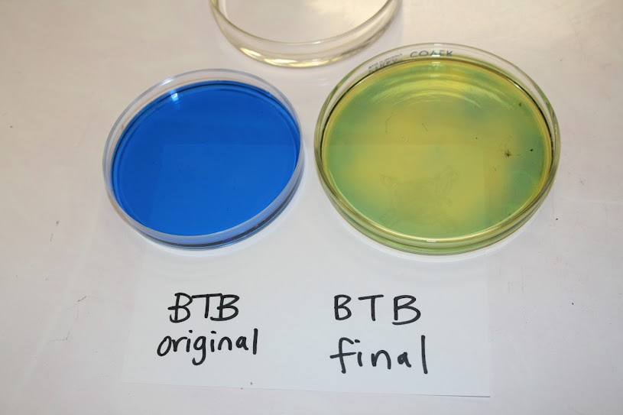
Results for Ms. Angle’s Class
Trial # | Initial mass of ethanol (g) | Final mass of ethanol (g) | Change in mass of ethanol (g) | start BTB color | end BTB color
1 | 24.00 | 22.97 | -1.03 | blue | yellow
2 | 20.63 | 19.43 | -1.20 | blue | yellow
3 | 33.22 | 32.54 | -0.68 | blue | yellow
4 | 27.23 | 26.59 | -0.64 | blue | yellow
5 | 32.01 | 31.21 | -0.80 | blue | yellow
6 | 27.37 | 26.73 | -0.64 | blue | yellow
How do your results compare with the results for Ms. Angle’s class?

Slide 20
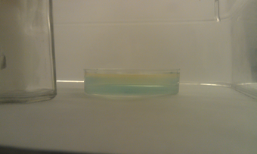
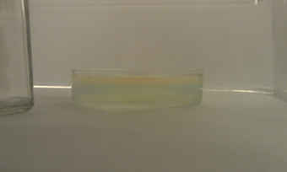
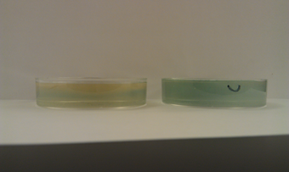
Evidence of CO₂ in air from burning
4 minutes
8 minutes
10 minutes, with control

Slide 21
Explaining Group Results
Explaining results for mass changes
How are the mass changes connected with The Movement Question: Where are atoms moving?
What unanswered questions do you have?
Explaining results for BTB changes
How are the BTB questions connected to The Carbon Question: What is happening to carbon atoms?
What unanswered questions do you have?

Slide 22
Lesson 4 Activity 3
Using molecular models to explain ethanol burning

Slide 23
ZOOMING INTO A

Slide 24
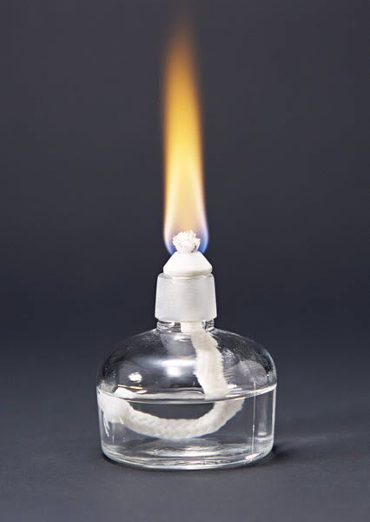
Driving question
What’s the hidden chemical change when ethanol burns?

Slide 25
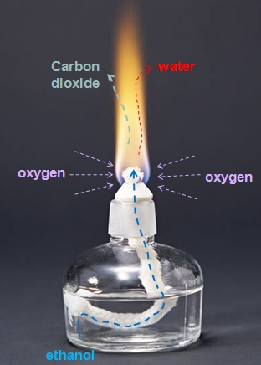
Movement of ethanol burning at macroscopic scale
Large scale
scales
Macroscopic
Microscopic
Atomic molecular
Matter
Analyzing
Material identity and transformation
Matter Movement
Energy
All filters
Energy forms and transformation
Back to blank
Notes:
This slide demonstrates the movement of molecules in a flame at macroscopic level.

Slide 26
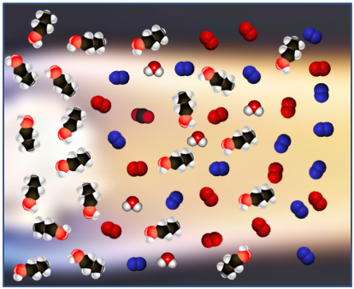
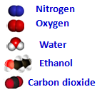
The bottom of flame at atomic-molecular scale
Ethanol mixed with air
Ethanol vapor
Notes:
This slide show the flame’s structure at microscopic level and ask more detailed question: what happens to the flame at microscopic level?

Slide 27
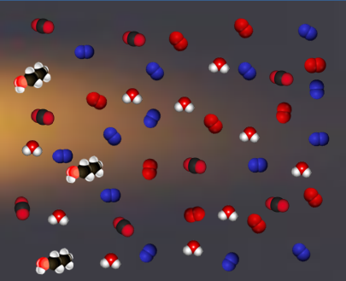
The top of flame at atomic-molecular scale
Air with less O₂, more CO₂ and H₂O vapor
Ethanol mixed with air
Notes:
This slide show the flame’s structure at microscopic level and ask more detailed question: what happens to the flame at microscopic level?

Slide 28
What happened between the bottom and the top of the flame?
Top of the flame
Bottom of the flame
Notes:
This slide show the flame’s structure at microscopic level and ask more detailed question: what happens to the flame at microscopic level?

Slide 29
How Atoms Bond Together in Molecules
Atoms in stable molecules always have a certain number of bonds to other atoms:
Carbon: 4 bonds
Oxygen: 2 bonds
Hydrogen: 1 bond
Oxygen atoms do NOT bond to other oxygen atoms if they can bond to carbon or hydrogen instead.
Chemical energy is stored in bonds between atoms
Some bonds (C-C and C-H) have high chemical energy
Other bonds (C-O and O-H) have low chemical energy

Slide 30
Making the Reactant Molecules: Ethanol and Oxygen
The flame of burning ethanol comes when ethanol (C₂H₅OH) reacts with oxygen (O₂). Make a molecules of ethanol and oxygen on the reactant side of your Molecular Models poster:
Get the atoms you will need to make your molecules. Can you figure out from the formula for ethanol how many C, H, and O atoms you will need?
Use the bonds to make models of an ethanol molecule (C₂H₅OH) and at least 3 oxygen molecules (O₂, with a double bond)
Identify the high-energy bonds (C-C and C-H) by putting twisty ties on them. How many high energy bonds does a molecule of ethanol have?
Compare your molecules to the pictures on the next slide. Are they the same?

Slide 31
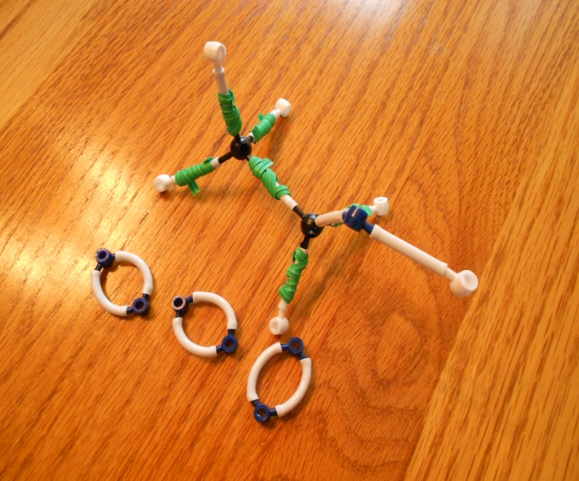
Photo of reactant molecules: H₂CO₃ (carbonic acid) Start by making the molecules and energy units of the reactants and putting them on the reactants side, then rearrange the atoms and energy units to show the products.
Chemical change
Reactants
Products
Remember: Atoms last forever (so you can rearrange atoms into new molecules, but can’t add or subtract atoms)
Energy lasts forever (so you can change forms of energy, but energy units can’t appear or go away)

Slide 32
Rearranging the Atoms to Make Product Molecules: Carbon Dioxide and Water
The flame of burning ethanol comes when ethanol (C₂H₅OH) reacts with oxygen (O₂) to produce carbon dioxide (CO₂) and water (H₂O). Show how this can happen:
The heat of the flame breaks the bonds in the molecules, so their bonds can break. Now they can recombine into carbon dioxide (CO₂) and water vapor (H₂O). Make as many of these molecules as you can from one ethanol molecule.
Figure out numbers of molecules:
How many O₂ molecules do you need to combine with one ethanol molecule?
How many CO₂ and H₂O molecules are produced by burning one molecule?
Remember, atoms last forever. So you can make and break bonds, but you still need the same atoms.
Remember, energy lasts forever. What forms of energy do the twisty ties represent now?
Compare your molecules to the pictures on the next slide. Are they the same?

Slide 33
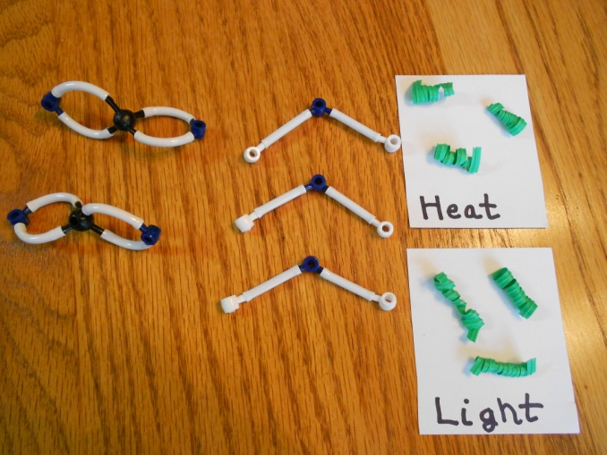
Photo of product molecules CO₂ and H₂O (carbon dioxide and water) Start by making the molecules and energy units of the reactants and putting them on the reactants side, then rearrange the atoms and energy units to show the products.
Chemical change
Reactants
Products
Remember: Atoms last forever (so you can rearrange atoms into new molecules, but can’t add or subtract atoms)
Energy lasts forever (so you can change forms of energy, but energy units can’t appear or go away)

Slide 34
Comparing photos of reactant and product molecules Start by making the molecules and energy units of the reactants and putting them on the reactants side, then rearrange the atoms and energy units to show the products.
Chemical change
Reactants
Products
Remember: Atoms last forever (so you can rearrange atoms into new molecules, but can’t add or subtract atoms)
Energy lasts forever (so you can change forms of energy, but energy units can’t appear or go away)

Slide 35
Writing a Chemical Equation
Chemists use chemical equations to show how atoms of reactant molecules are rearranged to make product molecules
Writing the equation in symbols: Chemists use an arrow to show how reactants change into products: [reactant molecule formulas] →product molecule formulas]
Saying it in words: Chemists read the arrow as “yield” or “yields:” [reactant molecule names] yield [product molecule names]
Equations must be balanced: Atoms last forever, so reactant and product molecules must have the same number of each kind of atom
Try it: can you write a balanced chemical equation to show the chemical change when ethanol burns?

Slide 36
Chemical equation for ethanol burning
C₂H₅OH + 3O₂ → 2 CO₂ + 3 H₂O
(in words: ethanol reacts with oxygen to yield carbon dioxide and water)

Slide 37
Three Questions Poster
Question | Rules to Follow | Evidence to Look For
The Movement Question: Where are atoms moving? Where are atoms moving from? Where are atoms going to? | Atoms last forever in combustion and living systems All materials (solids, liquids, and gases) are made of atoms | When materials change mass, atoms are moving When materials move, atoms are moving
The Carbon Question: What is happening to carbon atoms? What molecules are carbon atoms in before the process? How are the atoms rearranged into new molecules? | Carbon atoms are bound to other atoms in molecules Atoms can be rearranged to make new molecules | The air has carbon atoms in CO₂ Organic materials are made of molecules with carbon atoms Foods Fuels Living and dead plants and animals
The Energy Question: What is happening to chemical energy? What forms of energy are involved? How is energy changing from one form to another? | Energy lasts forever in combustion and living systems C-C and C-H bonds have more stored chemical energy than C-O and H-O bonds | We can observe indicators of different forms of energy Organic materials with chemical energy Light Heat energy Motion

Slide 38
Can you answer the Three Questions for ethanol burning now?
What are your ideas?
The Movement Question: Where atoms moving? (Where are atoms moving from? Where are atoms going to?)
The Carbon Question: What is happening to carbon atoms? (What molecules are carbon atoms in before the process? How are the atoms rearranged into new molecules?)
The Energy Question: What is happening to chemical energy? (What forms of energy are involved? How is energy changing from one form to another?)

Slide 39
What happens when ethanol burns?
Where are atoms moving from?
Where are atoms moving to?
Chemical change
What molecules are carbon atoms in before the change? What other molecules are involved?
What molecules are carbon atoms in after the change? What other molecules are produced?
What forms of energy are in the reactants?
What forms of energy are in the products?
Remember: Atoms last forever (so you can rearrange atoms into new molecules, but can’t add or subtract atoms) Energy lasts forever (so you can change forms of energy, but energy units can’t appear or go away)
Notes:
Teaser process tool for all investigations except soda water

Slide 40
The End

Slide 41
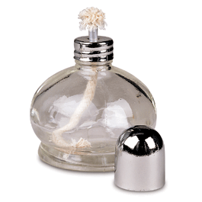
Optional Process Tool Slides: Chemical changes when ethanol burns

Slide 42
Materials in the flame
When ethanol burns, what happens to it and the things it needs to burn?
Heat energy
Heat energy
(in the air)
(in the air)
Ethanol
Ethanol
Mass of ethanol will decrease
water
water
carbon dioxide
carbon dioxide
Ethanol burning
oxygen
oxygen
Before
burning
After
burning
Predictions for change in mass
Notes:
--Purpose is to provide a format for students to express their thinking—their own account
--It is at macroscopic scale because experiences and empirical observations are at this scale
--Before, during, and after framing of the account is important for two reasons:
1. links to empirical observations—we measure change by comparing before with after, whether it is mass or is concentration
2. Shifts the account from actor-focus to system-focus
3. Foregrounds adoption of conservation principles—tracking throughout, even if M-E interconversion errors happen with Level 3 students

Slide 43
Analyze ethanol burning by filters at macroscopic scale
Large scale
scales
Macroscopic
Microscopic
Ethanol burning
Atomic molecular
Matter
Analyzing
Material identity and transformation
Matter Movement
Energy
All filters
Energy forms and transformation
Notes:
This slide demonstrates the transformation of photosynthesis at macroscopic level.

Slide 44
Energy transformation of ethanol burning at macroscopic world
Large scale
Heat energy
Light and heat energy
Chemical energy
scales
Macroscopic
Microscopic
Ethanol burning
Atomic molecular
Matter
Analyzing
Material identity and transformation
Matter Movement
Energy
All filters
Energy forms and transformation
Back to blank
Notes:
This slide demonstrates the transformation of photosynthesis at macroscopic level.

Slide 45
Matter transformation of ethanol burning at macroscopic world
Large scale
Ethanol
water
(from wick (liquid) to flame (vapor))
(From flame to air)
scales
Macroscopic
carbon dioxide
Microscopic
oxygen
Ethanol burning
(From air to flame )
(From flame to air )
Atomic molecular
Matter
Analyzing
Material identity and transformation
Matter Movement
Energy
All filters
Energy forms and transformation
Back to blank
Notes:
This slide demonstrates the transformation of photosynthesis at macroscopic level.

Slide 46
Transformation of ethanol burning at macroscopic world
Heat energy
Large scale
(in the air)
Light and heat energy
Chemical energy
Ethanol
water
(from wick (liquid) to flame (vapor))
(From flame to air)
scales
Macroscopic
carbon dioxide
Microscopic
oxygen
Ethanol burning
(From air to flame )
(From flame to air )
Atomic molecular
Matter
Analyzing
Material identity and transformation
Matter Movement
Energy
All filters
Energy forms and transformation
Back to blank
Notes:
This slide demonstrates the transformation of photosynthesis at macroscopic level.

Slide 47
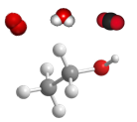
Analyze ethanol burning by filters at atomic molecular scale
Large scale
Energy forms
Energy movement
Energy Transformation
Macroscopic
Microscopic
scales
Atomic molecular
Matter
Analyzing
Material identity
Matter transformation
Energy
All filters
Energy forms and transformation

Slide 48
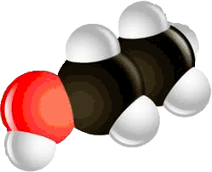
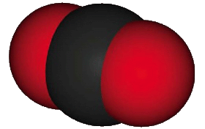
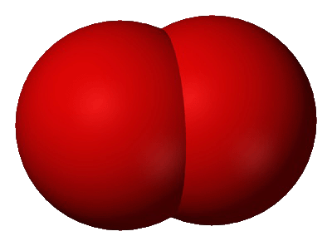
Matter transformation of ethanol burning at atomic-molecular world
Large scale
Energy forms
Energy movement
Energy Transformation
Macroscopic
C₂H₅OH
H₂O
Microscopic
scales
O₂
CO₂
Atomic molecular
Matter
Analyzing
Material identity
Matter transformation
Energy
All filters
Energy forms and transformation
Back to blank

Slide 49
Matter movement of ethanol burning at atomic-molecular world
Large scale
Macroscopic
C₂H₅OH
H₂O
Microscopic
scales
O₂
CO₂
Atomic molecular
Matter
Analyzing
Material identity
Matter transformation
Energy
All filters
Energy forms and transformation
Back to blank

Slide 50
Energy transformation of ethanol burning at atomic-molecular world
Large scale
Light and heat energy
Macroscopic
Chemical energy
(stored in bonds)
Heat energy
Microscopic
(Move to the air )
scales
Atomic molecular
Matter
Analyzing
Material identity
Matter transformation
Energy
All filters
Energy forms and transformation
Back to blank

Slide 51
Transformation of ethanol burning at atomic-molecular world
Large scale
Energy forms
Energy movement
Heat energy
Energy Transformation
Chemical energy
(stored in bonds)
(Move to the air )
Macroscopic
Light and heat energy
C₂H₅OH
H₂O
Microscopic
scales
O₂
CO₂
Atomic molecular
Matter
Next slide
Analyzing
Material identity
Matter transformation
Energy
All filters
Energy forms and transformation
Back to blank

